Slide 1

Payroll System Concept
Sit Dolor Amet

Slide 2
Features
Admin Dashboard
Employee Dashboard

Slide 3
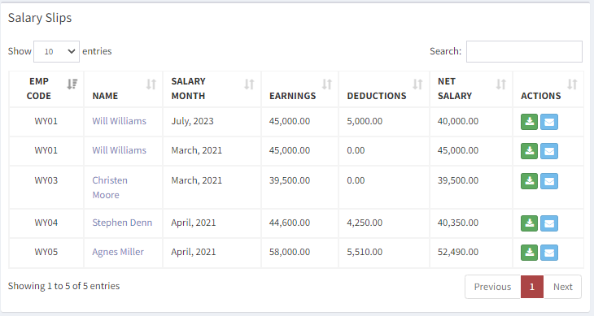
Admin Dashboard
It includes
Manage Employees
Attendance
Leave/Holiday Options
Add/remove/ Manage Employee
Multiple office Manager
Role Based User
Payroll Computation

Slide 4
Employee Dashboard
It includes
View
Salary Slips
Leaves
Holiday

Slide 5
Attendance Portal
Attendance Portal
Record in /out employee per office

